Slide 1

Electronic excited states of conjugated molecules and their lifetimes
Jaroslav V. Burda
Faculty of Mathematics and Physics
Charles University in Prague
Czech Republic

Slide 2
Motivation

Slide 3
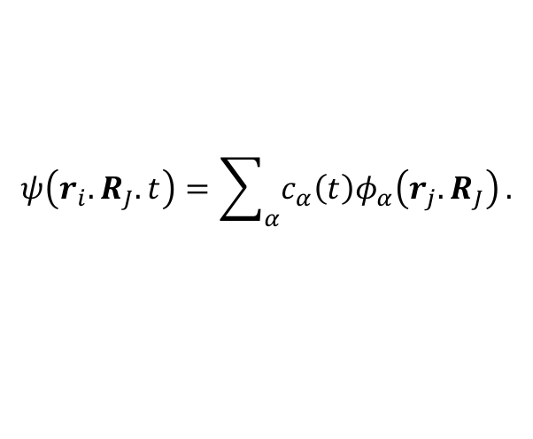
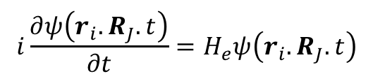
Computational tools
Estimation of Lifetimes of Excited States;
Semiempirical OM2/MNDO MD Simulations
Statistical treatment based on a swarm of a few hundred trajectories selected
from the ground state dynamic with time-step 0.5 fs and ca about 15ps long trajectories for the conformation-space search.
The excited-state dynamics: with a relatively small time-step (0.05 fs).
In each step time-dependent Schrodinger equation was solved
$$i\frac{∂ψ\left(r_{i}.R_{J}.t\right)}{∂t}=H_{e}ψ\left(r_{i}.R_{J}.t\right)$$
Stationary states form a basis for an expansion of the time-dependent wave function:
$$ψ\left(r_{i}.R_{J}.t\right)=\sum_{α}{c_{α}\left(t\right)φ_{α}\left(r_{j}.R_{J}\right)}.$$

Slide 4
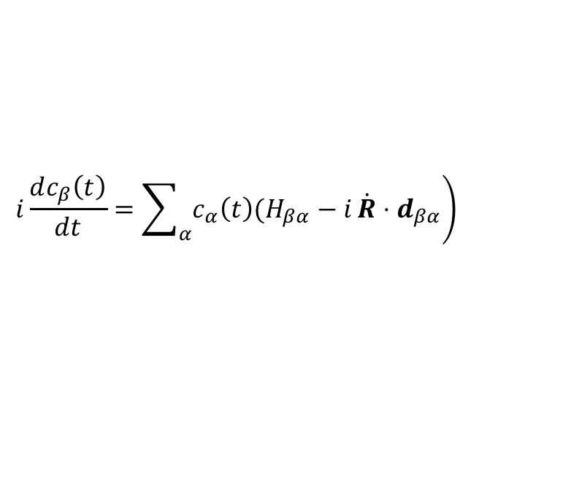
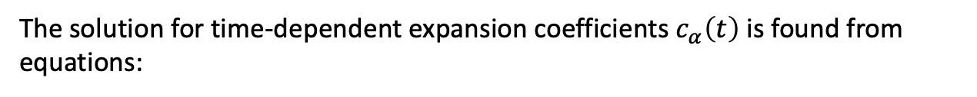



Computational tools
The solution for time-dependent expansion coefficients $c_{α}\left(t\right)$ is found from equations:
$$\left.i\frac{dc_{β}\left(t\right)}{dt}=\sum_{α}{c_{α}\left(t\right)(H_{βα}−i}\dot{R}⋅d_{βα}\right)$$
where individual matrix elements are defined as:
$$H_{βα}=\left\langle φ_{β} | H_{e} | φ_{α}\right\rangle$$
$$\dot{R}⋅d_{βα}=\left\langle φ_{β} | \frac{∂φ_{α}}{∂t}\right\rangle$$
is the nonadiabatic coupling term between the adiabatic electronic states α and β
$$d_{βα}=\left\langle φ_{β} | ∇_{R} | φ_{α}\right\rangle$$
is the derivative coupling vector and $\dot{R}$ is vector of the nuclear velocities

Slide 5
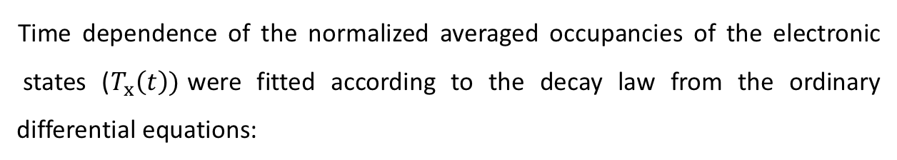
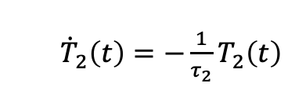
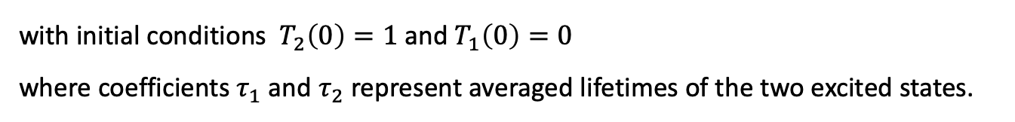
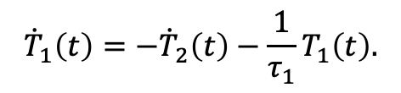
Computational tools
Time dependence of the normalized averaged occupancies of the electronic
states ($T_{x}\left(t\right))$were fitted according to the decay law from the ordinary differential equations:
${\dot{T}}_{2}\left(t\right)=−\frac{1}{τ_{2}}T_{2}\left(t\right)$
$${\dot{T}}_{1}\left(t\right)=−{\dot{T}}_{2}\left(t\right)−\frac{1}{τ_{1}}T_{1}\left(t\right).$$
with initial conditions $T_{2}\left(0\right)=1$ and $T_{1}\left(0\right)=0$
where coefficients $τ_{1}$ and $τ_{2}$ represent averaged lifetimes of the two excited states.

Slide 6
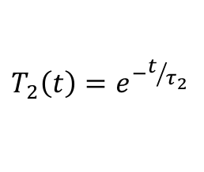

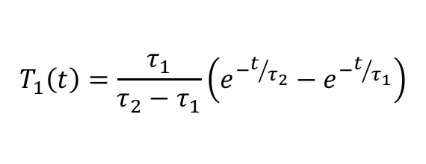
Pyrimidine nucleobases and triazines
Estimation of Lifetimes of Excited States
Cytosine - normalized averaged populations in time
only very short part of the state evolution from the beginning
$$T_{2}\left(t\right)=e^{−t/{τ_{2}}}$$
$$T_{1}\left(t\right)=\frac{τ_{1}}{τ_{2}−τ_{1}}\left(e^{−t/{τ_{2}}}−e^{−t/{τ_{1}}}\right)$$
$$T_{0}\left(t\right)=1{−T}_{1}\left(t\right){−T}_{2}\left(t\right)$$

Slide 7
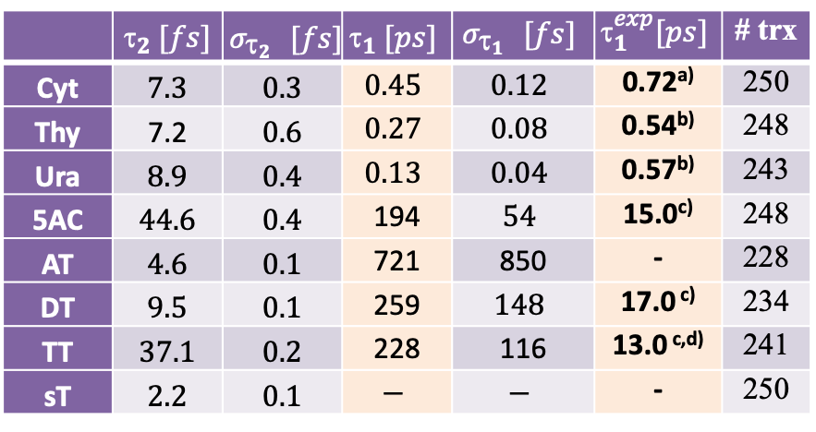
Estimated lifetimes τ₁ and τ₂ for deexcitation of the S₂ and S₁ states.
 | $$_{2} [fs]$$ | $$σ_{{_{2}}_{}}[fs]$$ | $$_{1} [ps]$$ | $$σ_{{_{1}}_{}}[fs]$$ | $$_{1}^{exp}[ps]$$ | # trx
Cyt | $$7.3$$ | $$0.3$$ | $$0.45$$ | $$0.12$$ | 0.72^{a)} | 250
Thy | 7.2 | $$0.6$$ | $$0.27$$ | $$0.08$$ | 0.54^{b)} | 248
Ura | $$8.9$$ | $$0.4$$ | $$0.13$$ | $$0.04$$ | 0.57^{b)} | 243
5AC | $$44.6$$ | $$0.4$$ | 194 | $$54$$ | 15.0^{c)} | 248
AT | $$4.6$$ | $$0.1$$ | 721 | 850 | - | 228
DT | $$9.5$$ | $$0.1$$ | 259 | $$148$$ | 17.0 ^{c)} | 234
TT | $$37.1$$ | $$0.2$$ | 228 | 116 | 13.0 ^{c,d)} | 241
sT | $$2.2$$ | $$0.1$$ | $$−$$ | $$−$$ | - | 250
^{a)} Peon, J.; Zewail, A. H. Chem. Phys. Lett. 2001, 348, 255-262
^{b)} Pecourt, J.-M. L.; Peon, J.; Kohler, B. J. Am. Chem. Soc. 2001, 123, 10370-10378
^{c)} Zhou, Z.; Zhou, X.; Wang, X.; Jiang, B.; Li, Y.; Chen, J.; Xu, J. J. Phys. Chem. A 2017, 121, 2780–2789
^{d)} Zhang, Y.; Beckstead, A. A.; Hu, Y.; Piao, X.; Bong, D.; Kohler, B. Molecules 2017, 21, 1645-1659
Nucleobases deexcite very fast (nothing new), all remaining molecules deactivates by several orders of magnitude longer.
In agreement with ref c) Zhou et al., it can be seen that triazines with more exo-cyclic amino-groups have less stable first excited state.
(in gas phase …)

Slide 8
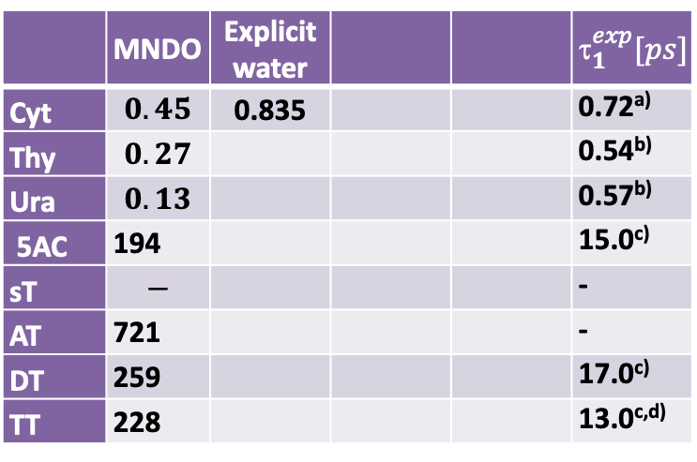
Estimated lifetimes τ₁ for deexcitation of the S₁ state.
 | MNDO | Explicit water |  |  | $$_{1}^{exp}[ps]$$
Cyt | $$0.45$$ | 0.835 |  |  | 0.72^{a)}
Thy | $$0.27$$ |  |  |  | 0.54^{b)}
Ura | $$0.13$$ |  |  |  | 0.57^{b)}
5AC | 194 |  |  |  | 15.0^{c)}
sT | $$−$$ |  |  |  | -
AT | 721 |  |  |  | -
DT | 259 |  |  |  | 17.0^{c)}
TT | 228 |  |  |  | 13.0^{c,d)}
Explicit water -> OM2/MNDO: cytosine with 20 water molecules
^{a)} Peon, J.; Zewail, A. H. Chem. Phys. Lett. 2001, 348, 255-262
^{b)} Pecourt, J.-M. L.; Peon, J.; Kohler, B. J. Am. Chem. Soc. 2001, 123, 10370-10378
^{c)} Zhou, Z.; Zhou, X.; Wang, X.; Jiang, B.; Li, Y.; Chen, J.; Xu, J. J. Phys. Chem. A 2017, 121, 2780–2789
^{d)} Zhang, Y.; Beckstead, A. A.; Hu, Y.; Piao, X.; Bong, D.; Kohler, B. Molecules 2017, 21, 1645-1659

Slide 9
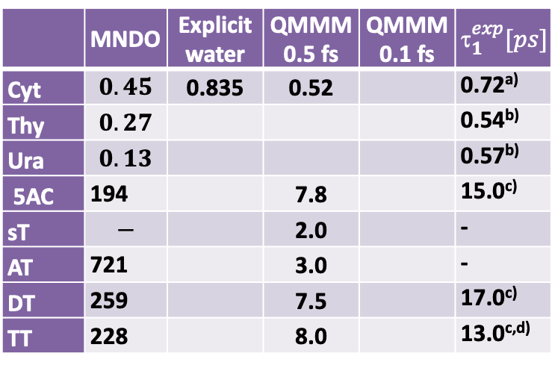
Estimated lifetimes τ₁ for deexcitation of the S₁ state.
 | MNDO | Explicit water | QMMM 0.5 fs | QMMM 0.1 fs | $$_{1}^{exp}[ps]$$
Cyt | $$0.45$$ | 0.835 | 0.52 |  | 0.72^{a)}
Thy | $$0.27$$ |  |  |  | 0.54^{b)}
Ura | $$0.13$$ |  |  |  | 0.57^{b)}
5AC | 194 |  | 7.8 |  | 15.0^{c)}
sT | $$−$$ |  | 2.0 |  | -
AT | 721 |  | 3.0 |  | -
DT | 259 |  | 7.5 |  | 17.0^{c)}
TT | 228 |  | 8.0 |  | 13.0^{c,d)}
Explicit water -> OM2/MNDO: cytosine with 20 water molecules
QMMM – qm solute + 300 water molecules using classical (SPCE) force field:
Newton-X (MNDO99 + Gromacs)
^{a)} Peon, J.; Zewail, A. H. Chem. Phys. Lett. 2001, 348, 255-262
^{b)} Pecourt, J.-M. L.; Peon, J.; Kohler, B. J. Am. Chem. Soc. 2001, 123, 10370-10378
^{c)} Zhou, Z.; Zhou, X.; Wang, X.; Jiang, B.; Li, Y.; Chen, J.; Xu, J. J. Phys. Chem. A 2017, 121, 2780–2789
^{d)} Zhang, Y.; Beckstead, A. A.; Hu, Y.; Piao, X.; Bong, D.; Kohler, B. Molecules 2017, 21, 1645-1659

Slide 10
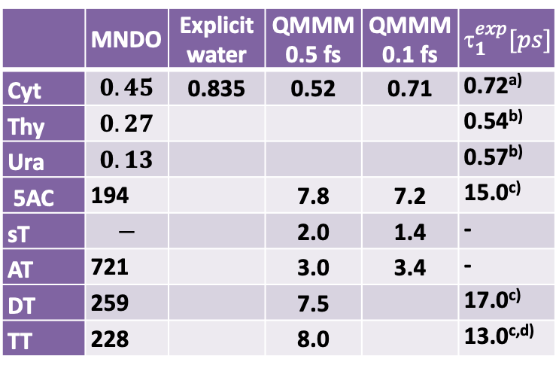
Estimated lifetimes τ₁ for deexcitation of the S₁ state.
 | MNDO | Explicit water | QMMM 0.5 fs | QMMM 0.1 fs | $$_{1}^{exp}[ps]$$
Cyt | $$0.45$$ | 0.835 | 0.52 | 0.71 | 0.72^{a)}
Thy | $$0.27$$ |  |  |  | 0.54^{b)}
Ura | $$0.13$$ |  |  |  | 0.57^{b)}
5AC | 194 |  | 7.8 | 7.2 | 15.0^{c)}
sT | $$−$$ |  | 2.0 | 1.4 | -
AT | 721 |  | 3.0 | 3.4 | -
DT | 259 |  | 7.5 |  | 17.0^{c)}
TT | 228 |  | 8.0 |  | 13.0^{c,d)}
Explicit water -> OM2/MNDO: cytosine with 20 water molecules
QMMM – qm solute + 300 water molecules using classical (SPCE) force field:
Newton-X (MNDO99 + Gromacs)
^{a)} Peon, J.; Zewail, A. H. Chem. Phys. Lett. 2001, 348, 255-262
^{b)} Pecourt, J.-M. L.; Peon, J.; Kohler, B. J. Am. Chem. Soc. 2001, 123, 10370-10378
^{c)} Zhou, Z.; Zhou, X.; Wang, X.; Jiang, B.; Li, Y.; Chen, J.; Xu, J. J. Phys. Chem. A 2017, 121, 2780–2789
^{d)} Zhang, Y.; Beckstead, A. A.; Hu, Y.; Piao, X.; Bong, D.; Kohler, B. Molecules 2017, 21, 1645-1659

Slide 11
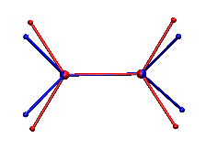
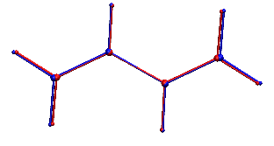
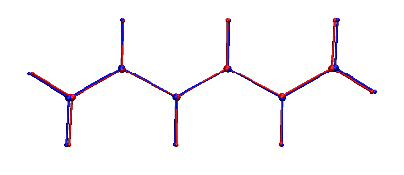
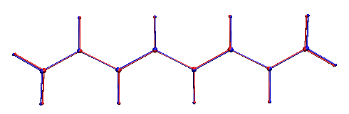
Polyenes
I. Vertical Excitation Transition Energies
Series of all-trans conjugated polyenes with #C from 2 to 22 was examined:
Ethene, Butadiene, Hexatriene, … Docosaundecaene. (BLYP/cc-pVDZ)
Only ethylene has one of the CH₂ end perpendicular to the other group.
All the other molecules have the S₁ geometry ‘slightly’ deformed in comparison with S₀.

Slide 12

MO’s dodecahexaene – BLYP/cc-pVDZ
(all remaining polyenes can be easily regarded):
41 - 4𝜋 44 LUMO
42 - 5𝜋 45 - 8𝜋*
43 HOMO 46 - 9𝜋*
In the Huckel method, difference equations can be solved analytically
obtaining MO energies
and MO expansion coefficients:

Slide 13
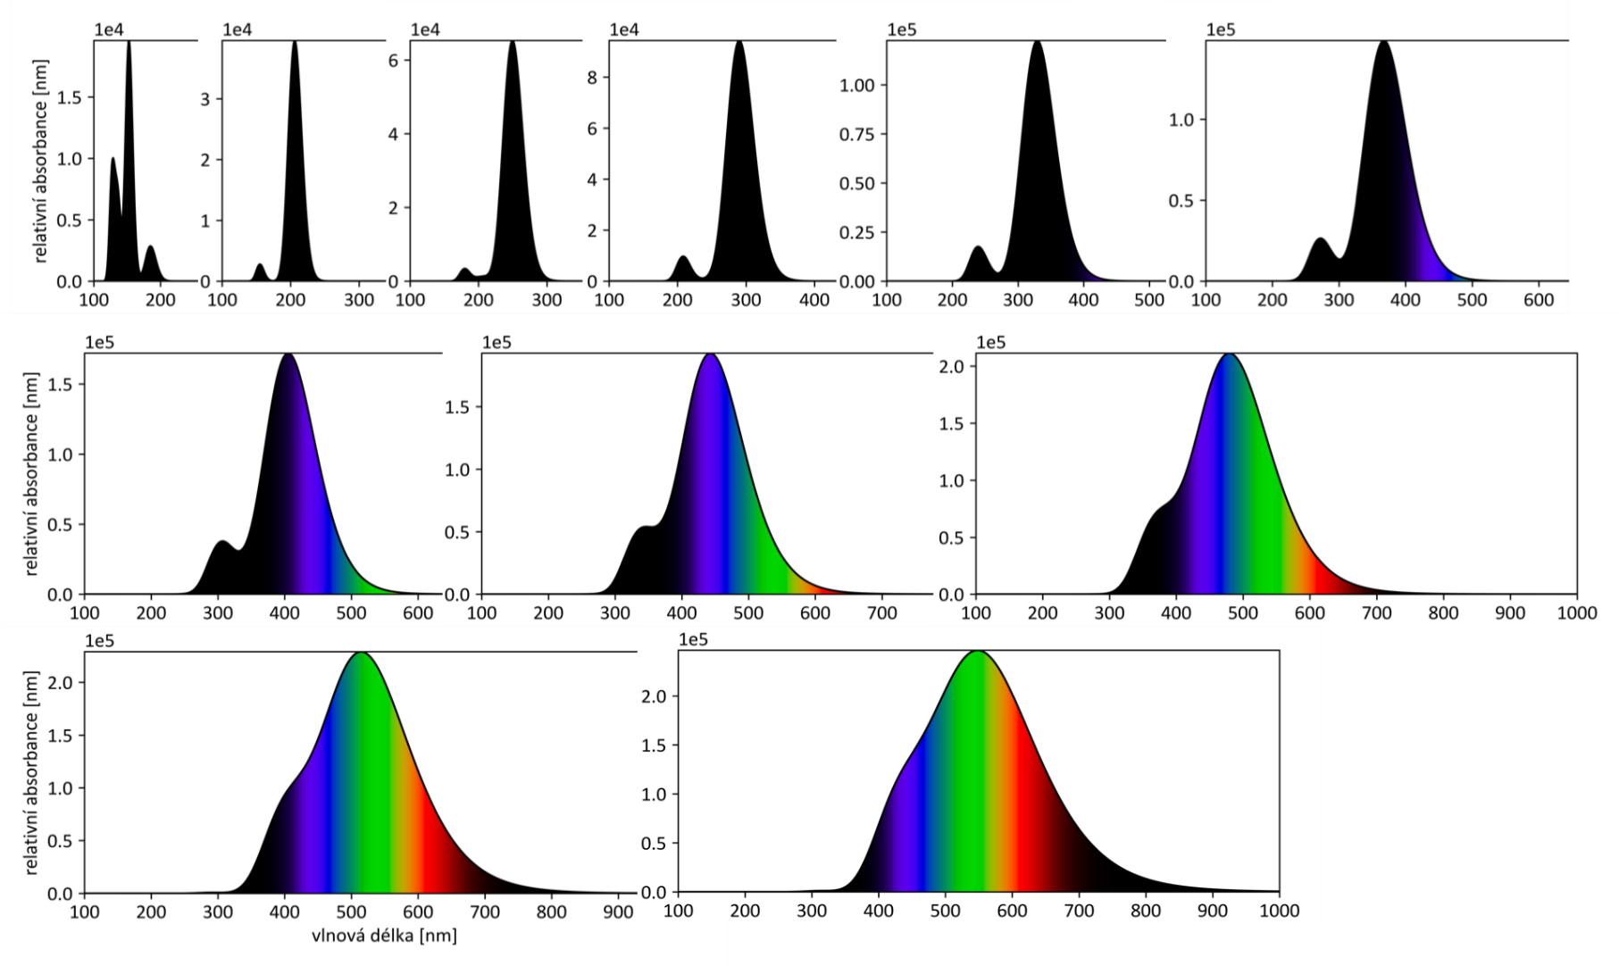
Calculated UV spectra TDA-PBE/def2-QVZPPD (broadening by Lorentz functions)
a) ethylene b) butadiene, c) hexatriene, d) octatetraene, e) decapentaene, f) dodecahexaene,
g) tetradecaheptaene, h) hexadecaoctaene, i) octadecanonaene, j) icosadecaene, and
k) docosaundecaene.

Slide 14
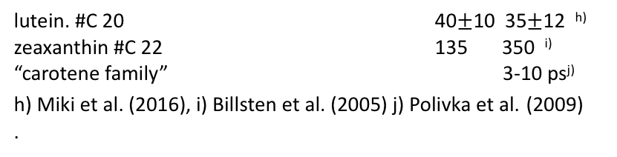
Polyenes
II. Estimation of Lifetimes of Excited States
Comparison of lifetimes from semiempirical MD simulations and available experiments.
molecule | τ₂ (fs) | τ₁ (fs) | # traj. | τ₂ exp | τ₁ exp
ethylene | 6 ± 1 | 109 ± 12 | 239 | 21ª | 80ª
butadiene | 13 ± 1 | 177 ± 36 | 159 | 44^{b} | 54^{b}
hexatriene | 38 ± 4 | 721 ± 95 | 213 | 40^{cd} | 270^{ce}
octatetraene | 396 ± 56 | 3276 ± 757 | 265 | 250^{f} | 340^{g}
decapentaene
dodecahexaene
tetradecaheptaene
hexadecaoktaene
octadecanonaene
icosadecaene
docosaundecaene
Octatetraene: time-dependent population of the T₁ and T₂ states used for fitting of the lifetimes averaged from 265 trajectories.
?
lutein. #C 20 40$±$10 35$±$12 ^{h)}
zeaxanthin #C 22 135 350 ^{i)}
“carotene family” 3-10 ps^{j)}
h) Miki et al. (2016), i) Billsten et al. (2005) j) Polivka et al. (2009)
.
^{gas phase ….}

